Slide 1
Presented by
Harshitha Marupaka
https://microsoft.github.io/autogen/stable/user-guide/core-user-guide/index.html

Slide 2
What is AutoGen?
Microsoft-Developed Framework
A cutting-edge multi-agent AI framework that enables seamless creation and orchestration of intelligent AI agents working in harmony.
Custom Role Definition
Define agents with tailored roles, specific prompts, and sophisticated collaborative workflows that adapt to your business needs.
Tool Integration
Seamlessly integrates with external tools and functions through APIs, enabling complex task automation and sophisticated problem-solving.

Slide 3


Getting Started with AutoGen
01
02
Open Source Access
Model Compatibility
Visit GitHub repository: github.com/microsoft/autogen for complete source code and documentation.
Full support for OpenAI, Azure OpenAI, and custom language models to suit diverse implementation needs.
03
Community Examples
Explore practical implementations: RPG simulation games, startup idea validation systems, and advanced group networking scenarios.
Quick Setup Requirements: Python 3.10s+ and virtual environment setup for optimal performance and compatibility.

Slide 4


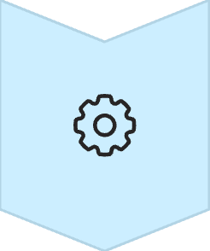
Why AutoGen? The Need for Agentic AI
From Isolation to Collaboration
Traditional AI models work in silos, but AutoGen breaks barriers by enabling multiple agents to collaborate intelligently and efficiently.
Human-Like Teamwork
Mimics natural human collaboration patterns: strategic planning, clear communication, thoughtful reflection, and intelligent tool usage.
Complex Workflow Mastery
Perfect for sophisticated workflows requiring diverse expertise, iterative improvement, and multi-step problem-solving approaches.

Slide 5




AutoGen Architecture Overview

Slide 6





AutoGen's Foundational Building Blocks
AutoGen's robust framework is built upon several interconnected components that enable sophisticated multi-agent systems.
Agents
Teams
Tools
The core intelligent entities, each defined by a name, a system prompt specifying its role and capabilities, and a set of available tools, enabling diverse problem-solving personas.
Groups of agents orchestrated to collaborate on complex tasks, leveraging AutoGen's conversation framework to coordinate efforts and achieve shared objectives efficiently.
External functions, APIs, and code execution environments that agents can access and utilize, significantly expanding their ability to interact with the real world and perform actions beyond LLM capabilities.
Messages
Models
The structured communication medium facilitating dynamic, multi-turn dialogues between agents, enabling seamless information exchange, task delegation, and coordinated decision-making.
The underlying Large Language Models (LLMs) that power the agents, providing their intelligence, understanding, reasoning, and generative capabilities to interpret prompts and formulate responses.

Slide 7
Agents

Slide 8





Controlling Agent Conversations: Termination Conditions
AutoGen provides flexible termination conditions to effectively manage agent workflows, preventing infinite loops and ensuring tasks are completed efficiently.
Max Rounds Termination
Keyword-Based Termination
Function-Based Termination
Ends the conversation after a predefined number of turns. Ideal for tasks with a known maximum interaction count to prevent indefinite execution.
The conversation ceases when a specific keyword or phrase is detected in any agent's message. Useful for tasks that have clear completion or error indicators.
A user-defined Python function evaluates the conversation history or agent state. The conversation terminates if this function returns True, allowing for complex, dynamic logic.
Timeout Termination
Custom Termination Conditions
Terminates the conversation if a specified duration of time elapses without completion. Essential for enforcing time limits and preventing agents from stalling.
A highly flexible approach that allows defining arbitrary rules, often combining multiple criteria, to programmatically control when an agent dialogue should conclude.

Slide 9




Human in the Loop: Empowering AutoGen with Oversight
Integrating human intelligence at key junctures ensures ethical, accurate, and aligned AI agent operations, enhancing reliability and control.
Human Approval Gates
Manual Intervention
Human Feedback Integration
Requires explicit human sign-off for critical decisions or deployments.
Allows humans to halt, correct, or redirect agent workflows when needed.
Incorporates human insights into agent learning for continuous improvement.
Escalation Mechanisms
Collaborative Workflows
Routes complex or high-risk situations to human experts for review.
Humans and agents work synergistically, leveraging each other's strengths.
Human oversight is invaluable in sensitive domains like finance, healthcare, and critical infrastructure management.

Slide 11
Article Writer Demo
Research Agent
Outline Agent
Writer Agent
Group Chat
Group Chat Manager

Slide 12





Key Benefits of AutoGen
Increased Productivity
Reduced Development Time
Scalable AI Solutions
Cost Efficiency
Improved Agent Collaboration
Easier Maintenance
Competitive Advantage

Slide 13
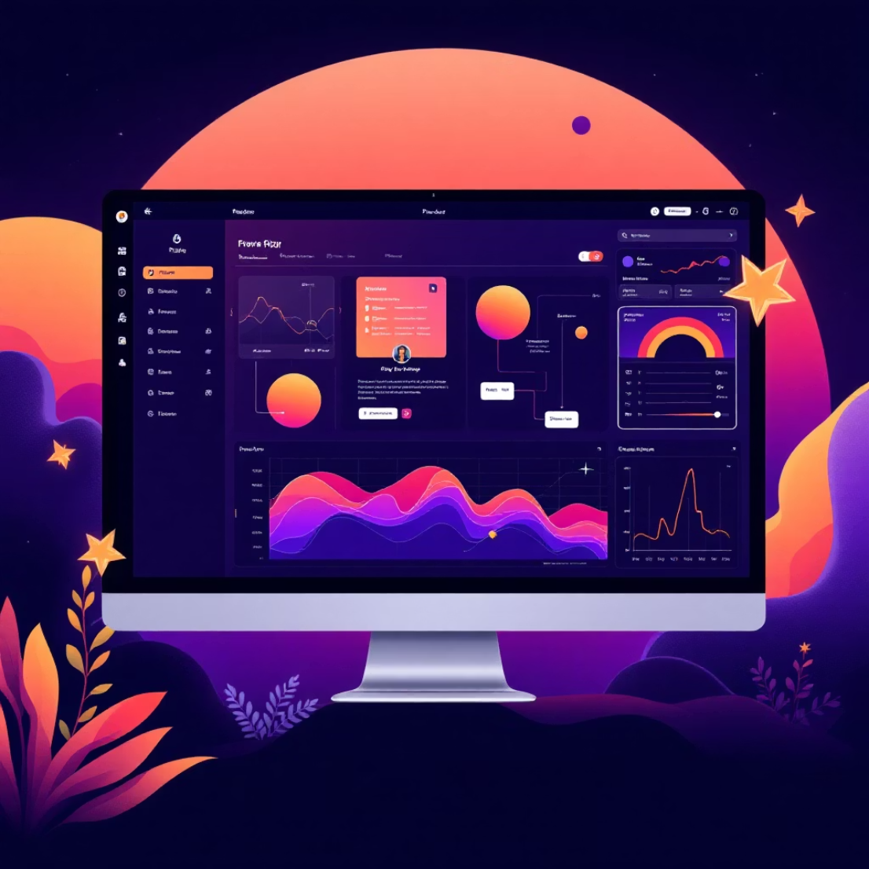
AutoGen Studio: Low-Code Agent Workflow Builder
Visual Interface Design
Comprehensive Customisation
Intuitive drag-and-drop interface to prototype and orchestrate complex agent workflows without extensive coding knowledge.
Easily customise language models, define agent skills, and configure sophisticated agent behaviors through user-friendly interfaces.
Accelerated Development
Significantly reduces development time for AI solutions on Azure OpenAI platform, enabling rapid prototyping and deployment.

Slide 14
Thank You

